Slide 1
2D drawing basics
For CSE 3902
By: Matt Boggus

Slide 2
Overview
2D coordinate systems
Raster images
Sprite drawing in MonoGame

Slide 3
Coordinate system
A coordinate system is a system which uses one or more numbers, or coordinates, to uniquely determine the position of a point
For a 2D coordinate system, we need
Origin
2-Tuple of position relative to the origin

Slide 4
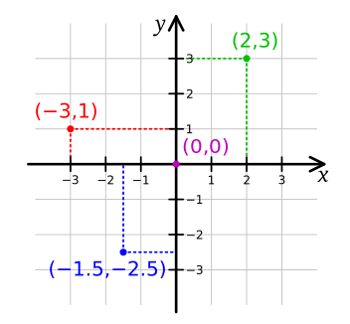
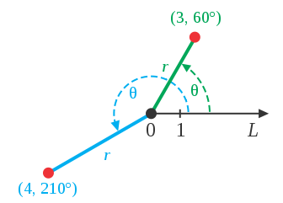
2D coordinate system examples
Cartesian Coordinates
(http://en.wikipedia.org/wiki/File:Cartesian-coordinate-system.svg)
Polar Coordinates
(http://en.wikipedia.org/wiki/File:CircularCoordinates.svg)

Slide 5
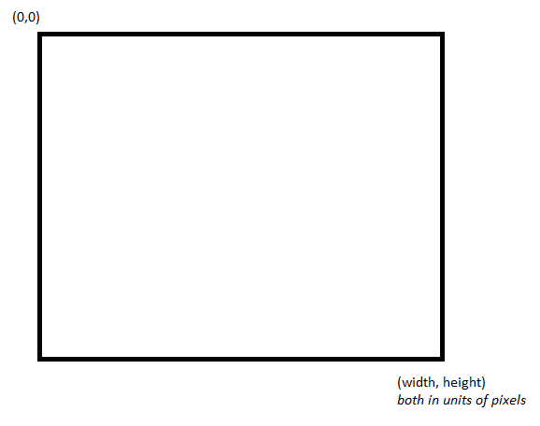
MonoGame’s coordinate system

Slide 6
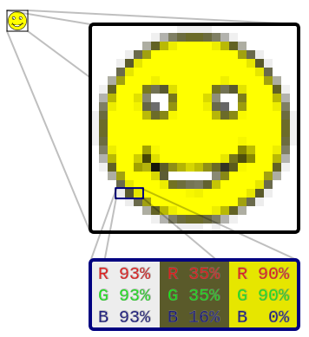
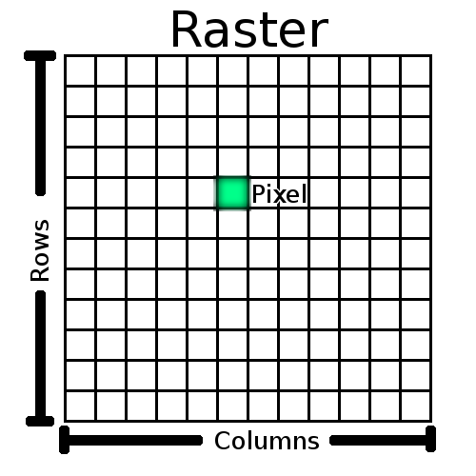
Raster images
http://docs.qgis.org/2.0/en/docs/gentle_gis_introduction/raster_data.html
http://en.wikipedia.org/wiki/File:Rgb-raster-image.svg

Slide 7
Raster image types
PPM
Uncompressed, human readable
GIF
8 bits per pixel per channel (RGB)
JPEG
Lossy data compression
PNG
Lossless data compression
More details on some of these formats (http://paulbourke.net/dataformats/ppm/)

Slide 8
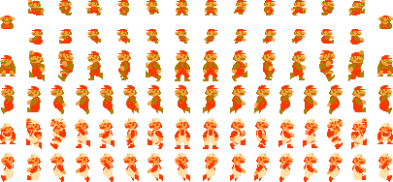
Comparing image types
File sizes for this Spritesheet
PNG ~6.42 kb
GIF ~12.8 kb
JPEG ~55.3 kb
BMP ~223 kb
PPM ~852 kb
----------------------------
Source code for NES SMB ~32 kb
Spritesheet from MarioUniverse.com
See http://web.cse.ohio-state.edu/~boggus/3902/ImageTypes for image files ; no NES ROM for comparison due to legal reasons

Slide 9
Sprite drawing in MonoGame
SpriteBatch object
Begin (call once to start specifying sprites to draw) [MSDN link]
Draw (each call specifies another sprite to draw) [MSDN link]
End (call once to finish specifying sprites to draw) [MSDN link]
[MonoGame link for SpriteBatch]

Slide 10


SpriteBatch Draw methods
public void Draw (
Texture2D texture,
Rectangle destinationRectangle,
Color color
)
Example Image File / Texture2D
public void Draw (
Texture2D texture,
Rectangle destinationRectangle,
Nullable<Rectangle> sourceRectangle,
Color color
)
Drawing window (example using MSPaint in class)

Slide 11
More examples
Sprite/Texture atlas example linked in Sprint0 list
http://rbwhitaker.wikidot.com/monogame-texture-atlases-1
Crude, but perhaps necessary example linked in course calendar
ManualAnimatedSprite.cs

